Slide 1
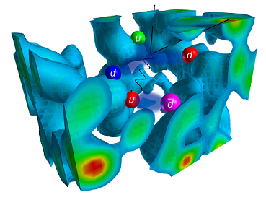
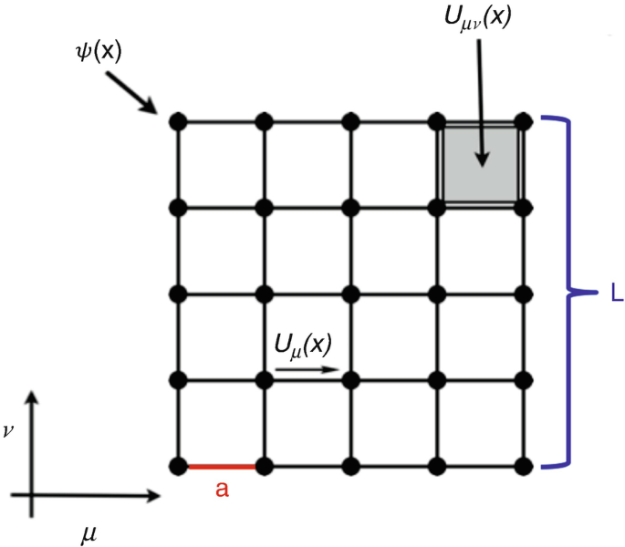
Correlation Function Analysis
Mentors:
Brij Kishor Jashal (TIFR)
Archana Radhakrishnan (TIFR)
Source:Ratti, C., Bellwied, R. (2021). Introduction to Lattice QCD.
Adam Zacharia Anil

Slide 2

Correlation Function Analysis
Adam Zacharia Anil
About me
I am an aspiring astrophysicist currently pursuing a BS-MS dual degree at the Indian Institute of Science Education and Research (IISER), Thiruvananthapuram. With a major in Physics and a minor in Data Science, I am passionate about unlocking the mysteries of the universe through the power of big data analysis and computational methods.
Where am I from
Kerala, India
I am from Kollam which is one of the 14 districts in Kerala
Research Interests
Astrophysics, Machine Learning
I am Interested Gravitational wave astrophysics, GRBs ,
Astro- particle -physics, Kilonoave
Website
More Info
https://www.adamzacharia.com/

Slide 3
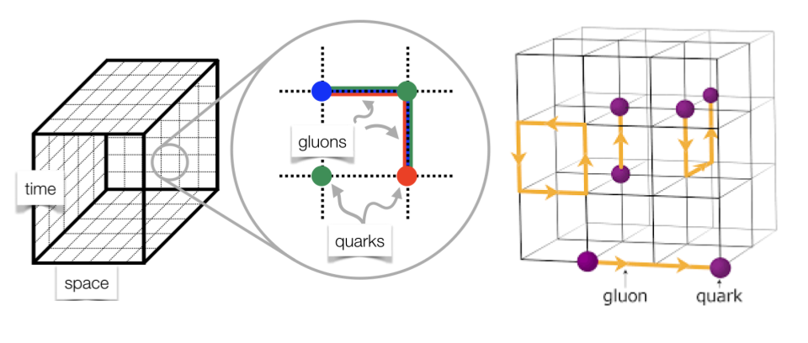
Correlation Function Analysis
What is Lattice QCD ?
Lattice QCD is a computational method in quantum physics that discretizes spacetime onto a grid or lattice. By doing this, it enables numerical solutions for the non-perturbative regime of Quantum Chromodynamics, which describes the strong force interactions between quarks and gluons.
Source: edyrd
Notes:
Imagine you want to understand how the tiny particles inside atoms (quarks and gluons) stick together. Lattice QCD is like a super-detailed Minecraft world for scientists. Instead of continuous land, they use blocks (or grid points) to represent space and time, which makes it easier to run computer simulations and figure out how these particles interact.

Slide 4
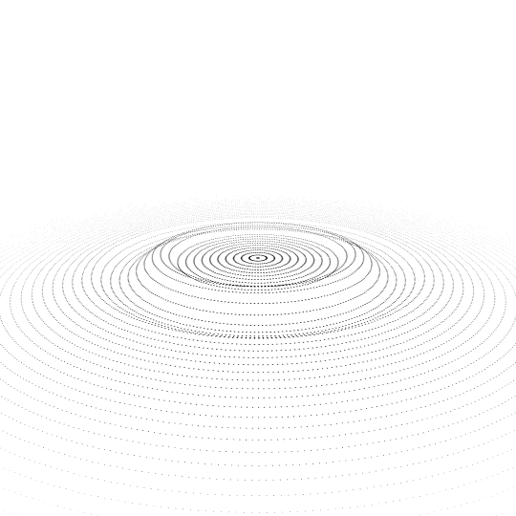
Correlation Function Analysis
What is Two point Correlation function ?
In Lattice QCD, a two-point correlation function measures the probability amplitude for a quark to propagate from one point in spacetime to another. Mathematically, it represents the expectation value of the product of two field operators, separated in time. By studying how this function decays with time separation, one can extract the mass of the bound state (like a proton or a pion) associated with the quark fields.
Notes:
Imagine you're dropping a stone into a pond and watching the ripples it creates. A two-point correlation function in Lattice QCD is like watching two specific points on the water to see how they respond over time. By looking at how the ripples at one point relate to the ripples at another point, we can figure out some properties of the tiny particles inside atoms.

Slide 5
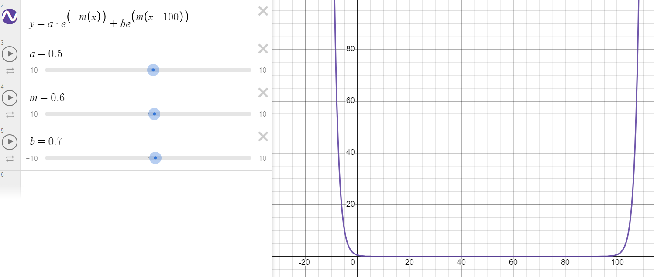
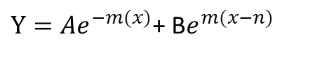
Correlation Function Analysis
So how do we fit?
Step 1
$Y=Ae^{−m(x)}$+ B$e^{m(x−n)}$
Identify and derive the required mathematical equation that represents the behavior of the system or process to be modeled.
Step 2
Using graphing calculators or platforms, like Desmos, to visualize the equation.
Step 3
Translating the mathematical equation into Python code

Slide 6
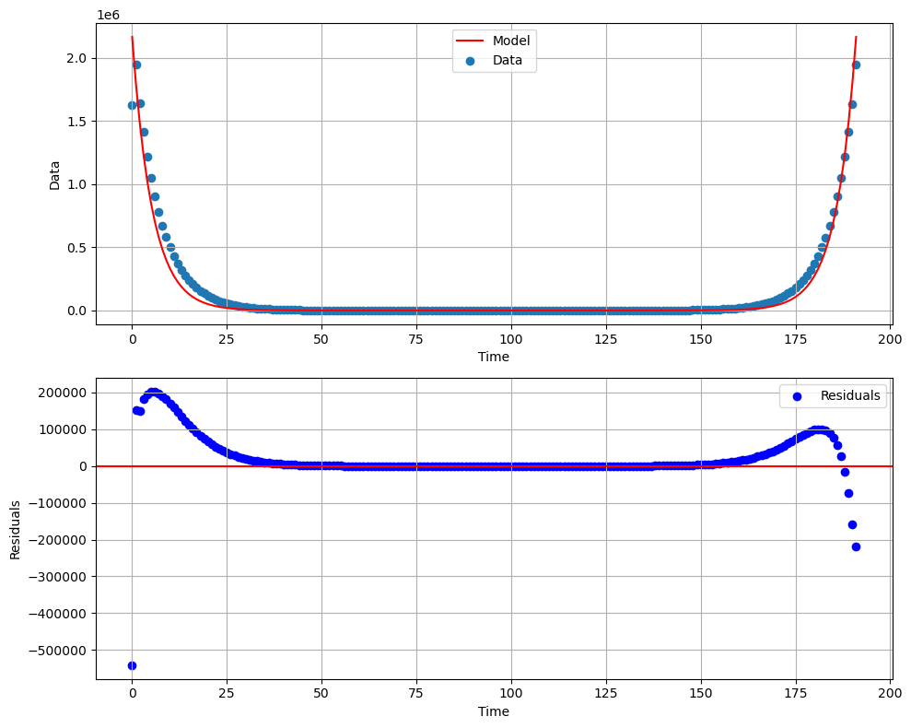
Correlation Function Analysis
The Final Result
Is this really the final result ??
How can we improve it??
How do you know if it’s a good model or not ??

Slide 7
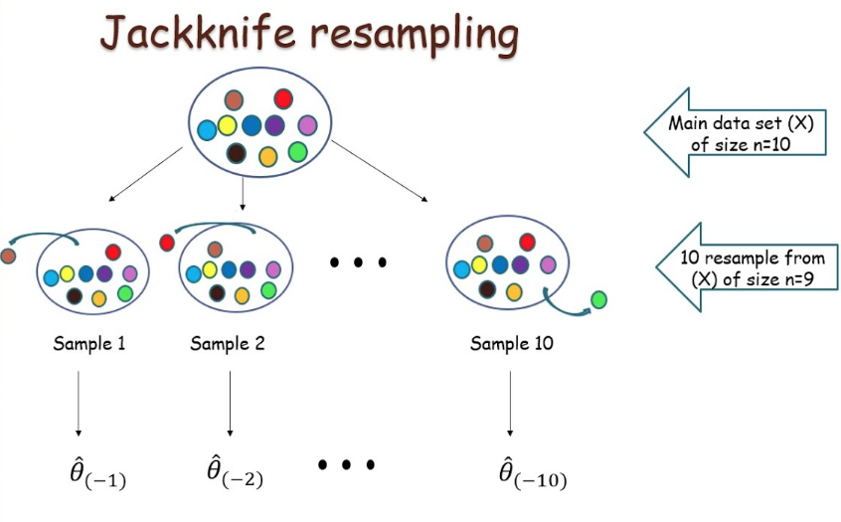
Correlation Function Analysis
Jackknife Resampling
The jackknife method involves systematically leaving out one observation at a time from the sample set and calculating the estimate over n-1 observations.
By doing this for all observations in the sample and examining the variation among the results, one can estimate the bias and variance of the estimator.
Source: Statistics Time
Notes:
Imagine you have a bag of mixed candies and you want to estimate the average weight of a candy. You might take a handful and average their weights. But, what if, by chance, you grabbed a handful with unusually heavy or light candies? The jackknife method is like weighing the candies in your handful one by one, leaving one out each time, to see if that candy was affecting the average weight a lot. This helps you understand if your average is reliable or if it's being skewed by just one or two candies.

Slide 8
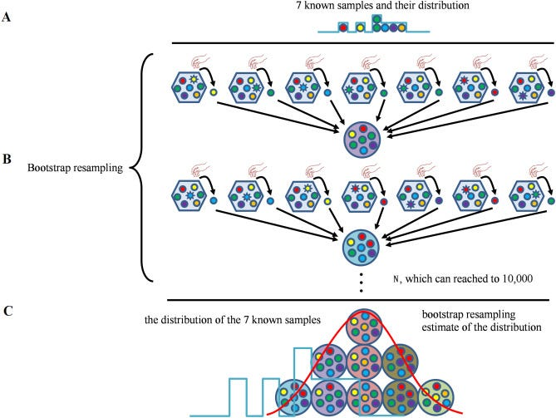
Correlation Function Analysis
Bootstrap Resampling
Bootstrap estimation is a powerful resampling technique used to infer the distribution of a statistic (like the mean or variance) by repeatedly sampling subsets of the observed data with replacement.
The key idea is to simulate the process of obtaining new sample sets by drawing from the original dataset. By doing this many times (say thousands or even millions), you can build an empirical distribution of the statistic and estimate its variance, confidence intervals, and more.
Source: Ming Cui et al (2017)
Notes:
Imagine you have a bag of mixed candies, and you want to guess the average weight of a candy. To use the bootstrap method, you'd take a handful of candies, record the average weight, then put them back in the bag and mix them up. You'd repeat this process many times. Each time you might get a slightly different average because you're picking candies randomly. After doing this many times, you'd look at all the averages you wrote down. The range and pattern of those averages give you a good idea about the true average weight of the candies in the bag and how sure you are about it!

Slide 9
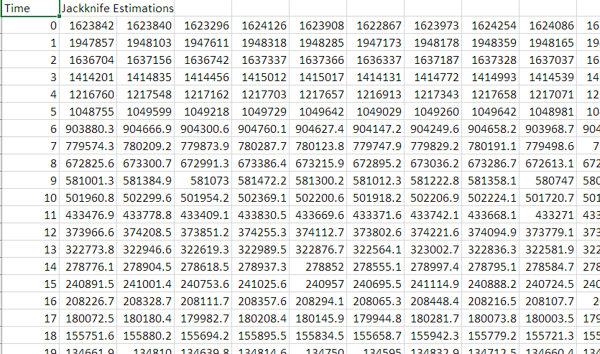
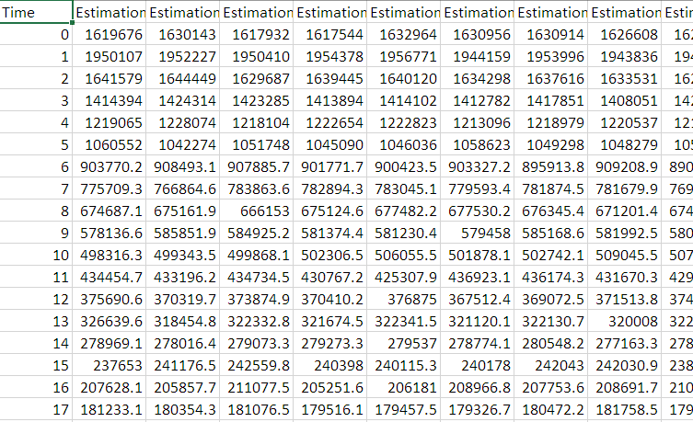
Correlation Function Analysis
Jackknife VS Bootstrap
Jackknife
- Simpler formulation
- Deterministic results
- Bias correction
Bootstrap
- Greater versatility
- Accurate error estimates
- Useful for complex statistics
Notes:
Advantages of Using Jackknife in Lattice QCD:
Simplicity: Jackknife is relatively straightforward and simpler in its formulation than bootstrap.
Deterministic: The jackknife procedure, which involves leaving out one observation at a time and recalculating the desired statistic, gives deterministic results each time it is applied.
Bias Correction: Jackknife can be effectively used to estimate and correct the bias of a sample estimator, which can be helpful in certain lattice QCD calculations.
Advantages of Using Bootstrap in Lattice QCD:
Versatility: Bootstrap is more versatile in the sense that it can be used to estimate the distribution of a wider range of statistics compared to the jackknife.
Better Error Estimates: Bootstrap, especially when using a large number of resamples, can provide more accurate estimates of standard error
Certainly, here's a concise version for your slide:
Jackknife vs. Bootstrap in Lattice QCD
Jackknife:
Simpler formulation
Deterministic results
Bias correction
Bootstrap:
Greater versatility
Accurate error estimates
Useful for complex statistics

Slide 10
Future plans

